Slide 1

Before we begin
Download Adobe Reader DC
Start Acrobat and press Ctrl+K. That opens the Preferences pop-up.
Select Reading, out of the categories on the left panel.
Verify that the drop-down Reading Order option is set to the Acrobat recommended option, 'Infer reading order from the document (recommended)'.
'Page vs. Document': should be set to 'Read the entire document' and 'Confirm before tagging documents' should be unchecked.
Then on the left panel, click Accessibility. In the Other Accessibility Options section, check the first two boxes if they are not already checked: 'Use document structure for tab order when no explicit tab order is specified', 'Enable assistive technology support'.
Click OK.

Slide 2

PDF Automation
UiPath Academy Module

Slide 3

PDF Files
2 Types of PDF Files
Native PDF
A PDF file that is originally generated in a computer, aka "born digital”
Scanned PDF
made up of scanned images of a given document
With scanned PDFs you will not be able to select text or use the search function because the PDF is a collection of images

Slide 4
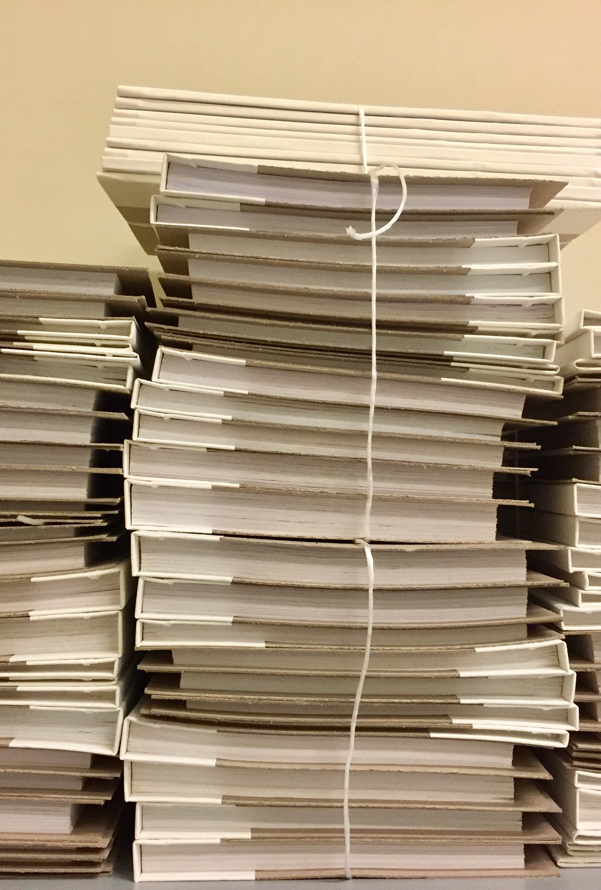
Extracting Data from PDF PDF Activities Pack | Read PDF Text | Read PDF with OCR
Read PDF Text Activity
More accurate
Only works with native PDF documents
Read PDF with OCR Activity
Used for extracting text from scanned documents
Using Screen Scraping

Slide 5

Questions?
Comments? Concerns? Violent Reactions?

Slide 6

Discussion Questions
What are the different types of PDF files?
How do you extract data from a PDF?

